Slide 1

Team 14
Policy Effects on COVID-19
Zach Meurer, Zach Gentile, Lize Chen, Jessica Cannon, Sam Yard & Zoe Yu-ya Tseng

Slide 2
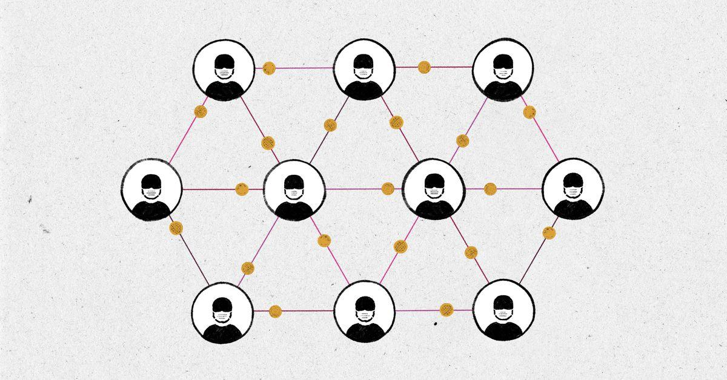
Roles
Zach Meurer
Zach Gentile
Lize Chen
Data Engineer
& Leader
Data Engineer
& Manager
Data Analyst
Jessica Cannon
Sam Yard
Zoe Yu-ya Tseng
Data Analyst
Data Developer
Data Analyst

Slide 3

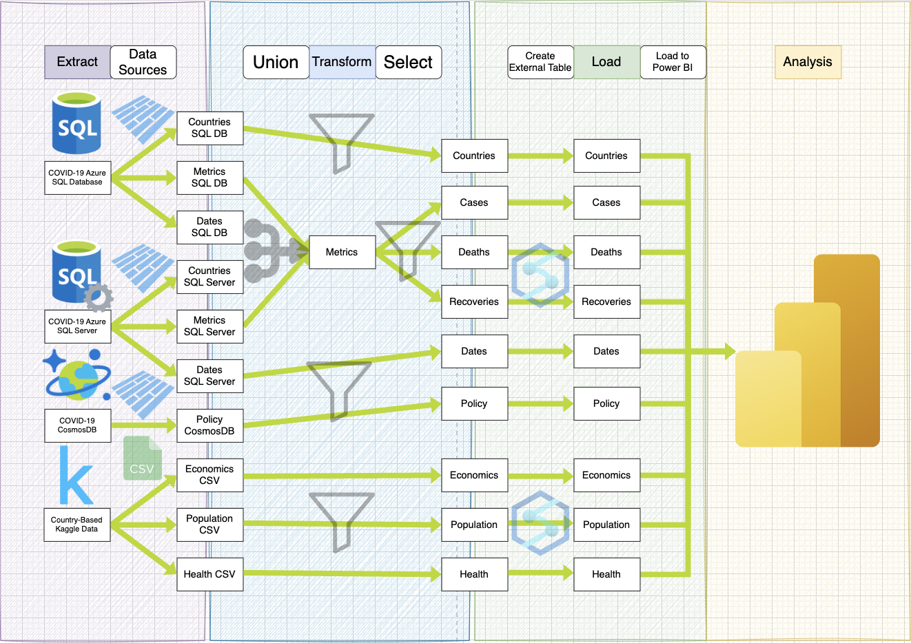
Data Architecture

Slide 4
Contact Tracing
0 | None
1 | Limited
2 | Comprehensive

Slide 5
Contact Tracing
0 | None
1 | Limited
2 | Comprehensive

Slide 6

International Travel Controls
0 | None
1 | Screening Arrivals
2 | Quarantine Arrivals from Some Regions
3 | Ban Arrivals from Some Regions
4 | Ban Arrivals from All Regions

Slide 7
International Travel Controls
0 | None
1 | Screening Arrivals
2 | Quarantine Arrivals from Some Regions
3 | Ban Arrivals from Some Regions
4 | Ban Arrivals from All Regions

